Slide 1
High Speed SerDes Transmitters and IC Design Automation
Dan Fiumara

Slide 2
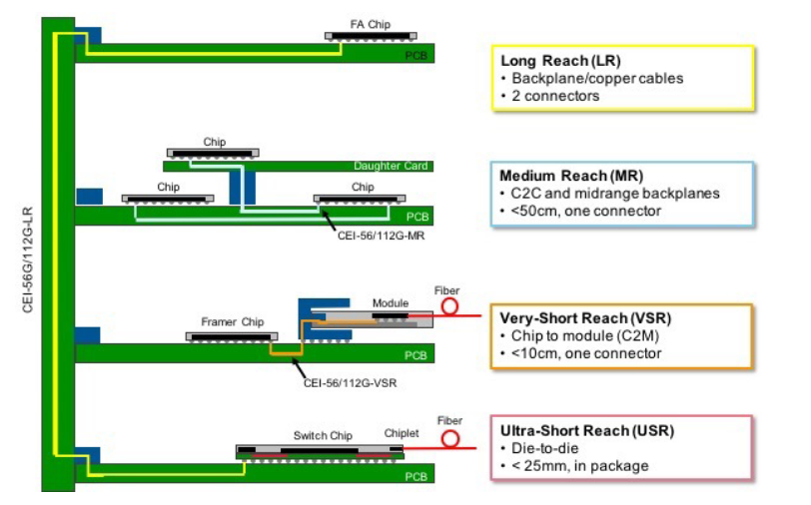
The Need for High Speed Links
AI/ML workloads are increasingly expensive
Datacenters deploy thousands and thousands of GPU’s to train and run LLM’s
We need a way to communicate between compute with very low latency to orchestrate these resources

Slide 3
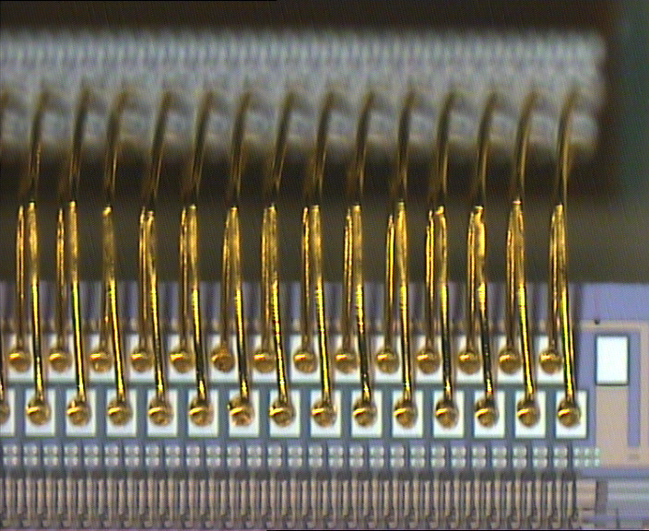
Communication Interfaces
Parallel Data Bus
Simple to implement
Very high speed
What is the tradeoff?
I/O is more expensive than transistors
Parallel data bus spends lots of I/O for speed
Transistors are cheap!
Can we use transistors to save I/O?

Slide 4
Serial Link
Serial Communication
Spend less on I/O
Require our infrastructure to be fast (very fast)
We need to communicate for highly parallel workloads
Our data is parallel at execution time
We can Serialize the data, transmit, receive, then Deserialize
Increase the Shoreline Bandwidth Density of our link

Slide 5
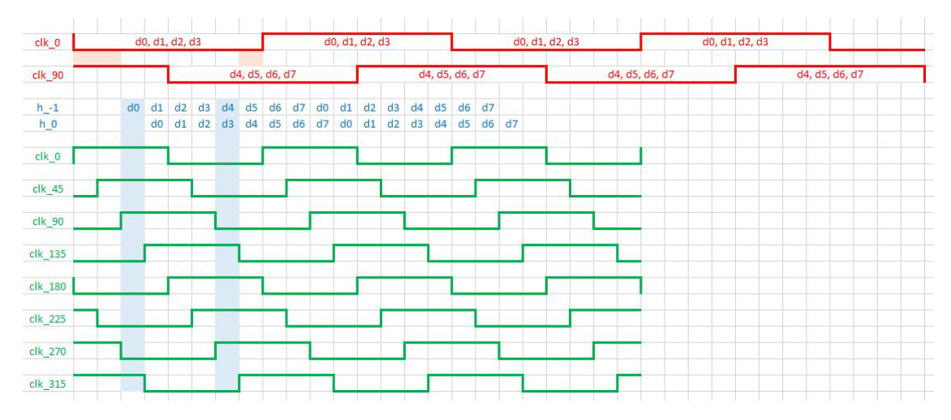
SerDes
Serializing parallel data (at high speeds)
How do we operate a circuit very fast? (clock generation)
Fmax of a modern transistor is ~300GHz
Becomes unstable long before 300GHz though

Slide 6
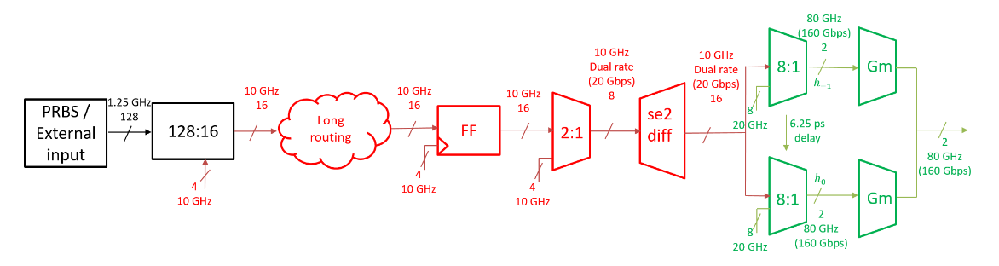
SerDes
We can use basic digital circuit building blocks to serialize our data

Slide 7
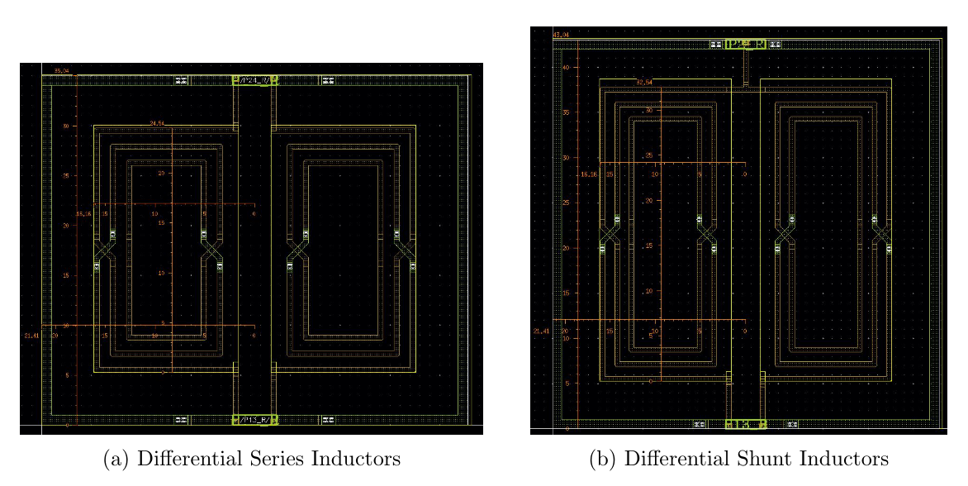
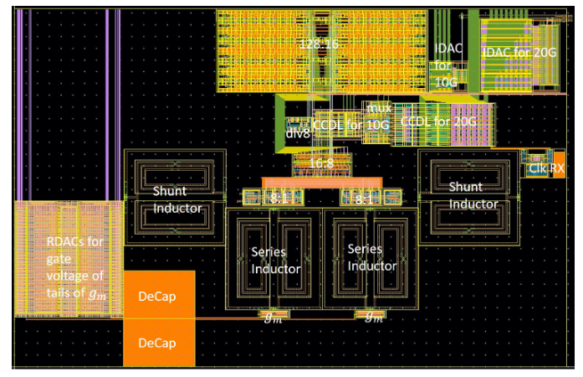
SerDes
Peaking structures
How can we compensate for parasitic capacitance?
We can utilize inductive peaking structures

Slide 8
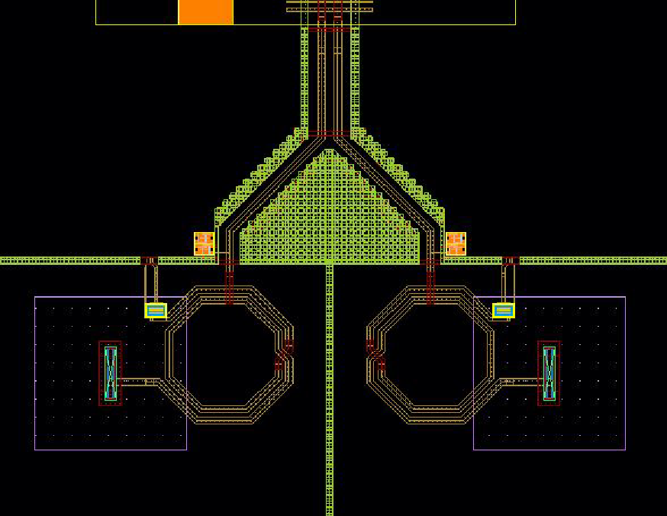
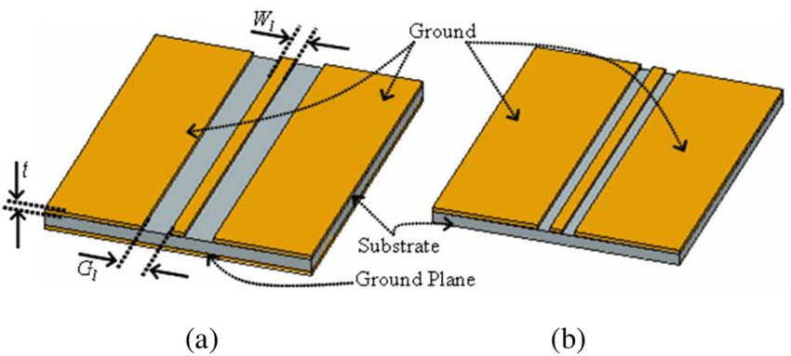
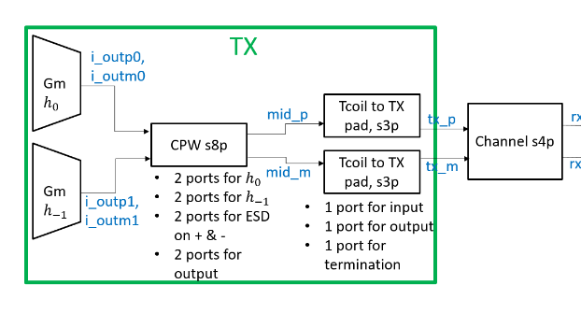
Coplanar Waveguides
Once our signal is very high speed (microwave region) we transport it with a waveguide
CPW is a planar transmission line (designed to minimize power loss)

Slide 9
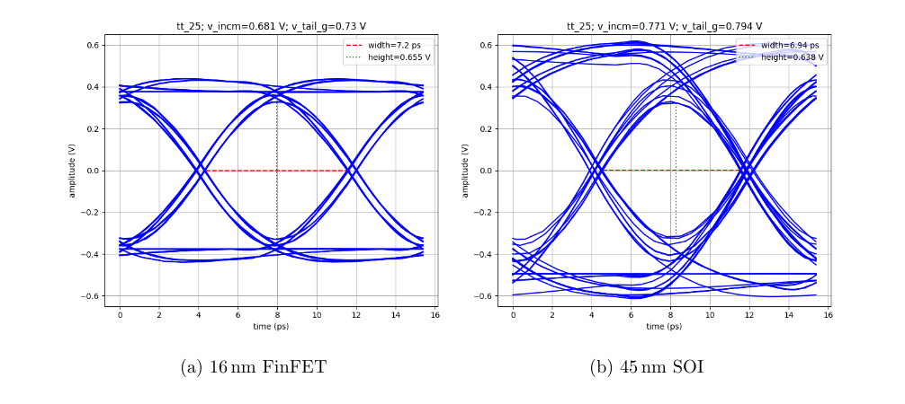
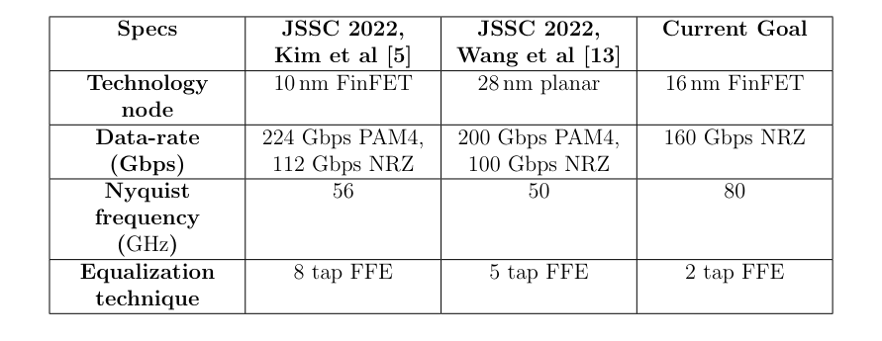
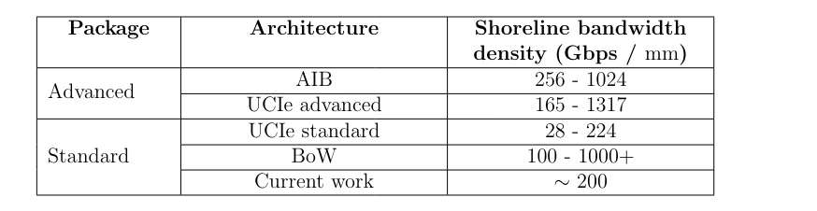
Results
Shoreline Bandwidth Density = Gbps / mm
This work achieved ~200 Gbps/mm

Slide 10
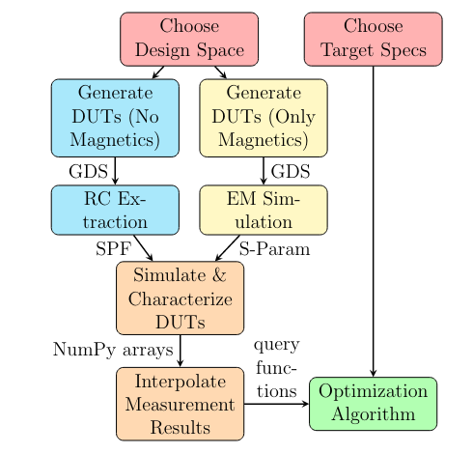
IC Design Automation
Many aspects of this SerDes transmitter design were automated
Generators (code defined schematics)
Optimization loop
This is ground breaking!
Analog IC Automation is hard

Slide 11
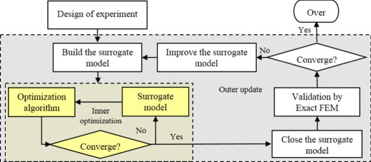
IC Design Automation – Surrogate Models
Spice simulation is SLOW
EM Simulation is SLOWER
Iterating on designs takes too much time
Can we approximate the simulator’s results with a deep neural network?

Slide 12

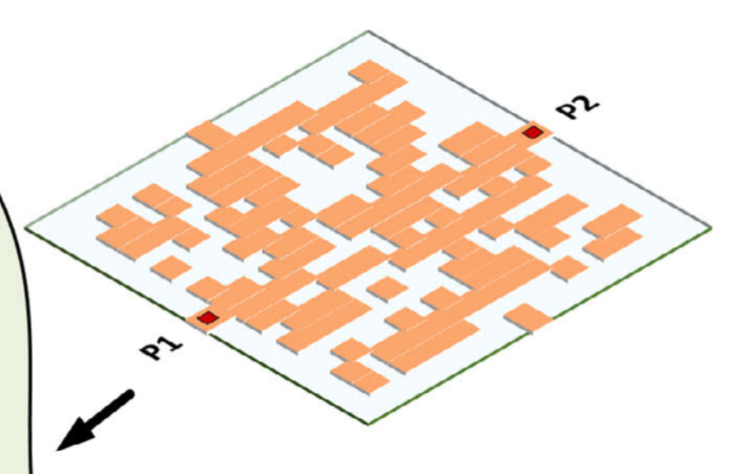
IC Design Automation – Inverse Design
Humans design intuitive shapes
What does the OPTIMAL shape look like?

Slide 13
References
Same as report

